Slide 1
NU Library at a Glance
Annual Review of 2014 and
Future Plans for 2015

Slide 2
The Collection Size
Types of materials | 2010 | 2011 | 2012 | 2013 | 2014 | Total
Books | 3684 | 31110 | 23473 | 23188 | 25394 | 106849
CD/DVD | 109 | 282 | 909 | 916 | 28 | 2244
Microforms |  |  | 687 | 1137 | 11 | 1835
TOTAL | 3793 | 31392 | 25069 | 25241 | 25433 | 110928
Language | 2011 | 2012 | 2013 | 2014 | Total | %
Kazakh language | 28 | 7646 | 1803 | 1981 | 12155 | 11%
Russian language | 141 | 3247 | 1123 | 1844 | 6853 | 7%
English language | 3624 | 20499 | 22143 | 21416 | 91920 | 82%
TOTAL | 3793 | 31392 | 25069 | 25241 | 110928 | 100%

Slide 3
Collection by Genres – 61% Multicopies of Textbooks
Genre | 2012 | 2013 | 2014
Research collection | 6963 | 8650 | 12 573
Textbooks | 33976 | 51367 | 68 012 (+68%)
Reference materials | 11992 | 16214 | 18 917
Fiction | 7323 | 9264 | 11 426
TOTAL | 60254 | 85495 | 110 928
Note: Despite our previous attempts to expand the library’s research collection, the largest increase occurs when course textbooks are being ordered. In accordance with faculty’s requests, it is the responsibility of the library to ensure that each student has a copy of their textbooks.

Slide 4
The Multimedia Collections
Microform Collection
  Copies of newspapers and magazines published in 19th -20th centuries in Kazan, Tashkent, Baku, and Orenburg
  The largest microform collection in Kazakhstan.
  Purchased for the School of Social Sciences and Humanities
Media Collection
  Audiobooks
  Music CDs
  DVDs – movies and documentary movies

Slide 5
E-Resources Collection
48% of the total budget of the Library
78 full text collections, reference resources, magazines, search and statistics tools, and other electronic resources
18 online textbooks and course materials for NU Schools
5, 554 e-books were purchased, for a total collection of 9, 291 titles

Slide 6
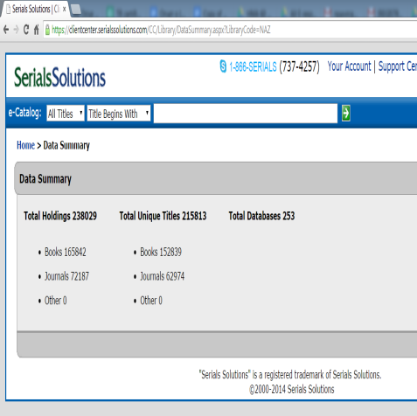
Extensive electronic subscriptions need effective ways to manage them
The federated search tool Summon as a way to search all databases
360 Counter as a tool for gathering usage statistics
360 Link as a tool for compiling a list of all journals
Plan for 2015:
  Keep the same list of resources + additional for NUSOM and School of Mining
  Increase usage statistics

Slide 7
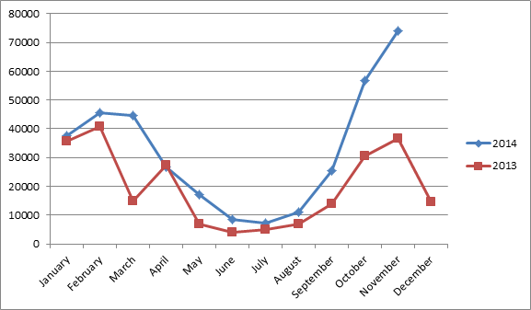
Monthly Usage of Full-Text Resources in 2014 and 2013

Slide 8
Digital Projects
"NU in History” Collection: a database focused on gathering and cataloging materials about the activities of Nazarbayev University.
  80+ articles
  200 videos and photos
  Reading/watching/listening online on library’s portal (www.library.nu.edu.kz).
Digital collection of rare books
  History of Central Asia and Kazakhstan by John Schoeberlein and Danielle Ross, Associate Professors at NU
  181 books were digitized for this collection
  We will continue this project in 2015

Slide 9
The University Repository
The Institutional Repository is an open archive for the published works of Nazarbayev University professors and researchers which will promote their recognition and increase their number of citations
UR regulatory documents have been approved
The portal has been tested
Only 29 articles were uploaded, instead of the 50 planned
Repository materials are available at the following link: library.nu.edu.kz/wps/portal/repository
Due to the functionality problems it was decided to switch to Dspace
In 2015 at least 100 publications should be uploaded

Slide 10
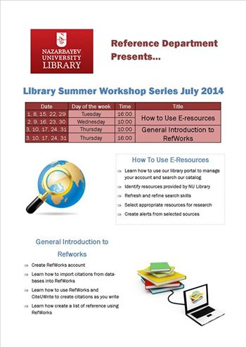
More Statistics
4, 102 active patrons
46, 649 library visits
153 instruction sessions with 2, 295 participants, including 2, 055 students and 240 faculty and staff
  42 of these sessions are regular workshops offered by the Reference Department
  111 of them requested by teachers and schools
Interlibrary Loan (ILL) - 427 articles requested through ILL from UWM. 394 articles delivered
Plan for 2015
  Keep the same interactivity of the library usage

Slide 11
Subject Librarians
Case study: embedded librarianship in mathematics - "Kazakhstan 2050 – Modernization of education - active learning – problem based learning (PBL)" is a joint publication by a NU professor and librarian that came from a suggestion to require students to use 10 peer-reviewed sources in their assignments to increase their knowledge and improved their information literacy.

Slide 12

Events
(extra-curricular activity meetings )
Clubs
  Reading Club
  Movie Club
  Poetry Club
Actions
  “One University - One Book“
  Book safety program
Library digests (once a month)
Social networks
  Facebook
  Twitter
  Instagram
Book Displays
  "Blind Date with a Book“
  "Pi Day”
We will continue this work in 2015

Slide 13

More Projects
"My Dagestan" by Rasul Gamzatov crowdsourcing reading project - a video reading on fragments of a story called "My Dagestan”. This is our contribution to our Dagestani colleagues’ project.
Personal Librarian Project (PL) is designed so that every student and teacher will be able to choose their "own" librarian. Such personalized contact attracts patrons through communication with a particular librarian, who they can communicate with like old friends and ask questions that they might hesitate to ask the librarian on duty.
We will continue this work in 2015

Slide 14
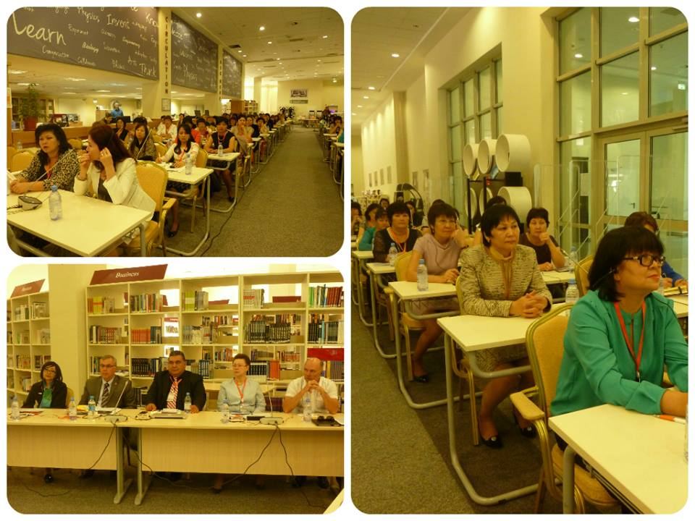
Sharing Experiences
5 events to share experience (seminars, workshops, conferences) which were attended by 200 librarians from all over Kazakhstan
12 publications by library staff
We will continue this work in 2015

Slide 15
General review
The key users of the library were provided with necessary materials
Access to electronic collections of journals and books
Reference services and support
Continue to build the library staff with qualified librarians
The library is on its way to becoming a leader in the Kazakh library community and positioning itself as a training center for Kazakh librarians

Slide 16
Plans for 2015
Organizing a core collection of medical resources; and building the reference skills to provide services to Medical School faculty and students;
Increasing e-book collection (perpetual use);
Switching to the Library of Congress Classification;
Forming a team of elite, professional librarians from local specialists;
Procuring the equipment, furniture, and spatial location for the new library building

Slide 17
The Research Library
©Loretta O’Donnell
Embedded librarians
Creating a research mindset in students
Librarians as curators of knowledge, collaborating early and often with faculty
Create an environment where “intellectual adventurers” will flourish
Librarians as navigators and guides, central to unleashing the intellectual potential of the scholarly community

